Slide 1
CS5351 Software Engineering 2025/26 Semester A Technical Debt
Dr W.K. Chan
Department of Computer Science
Email: wkchan@cityu.edu.hk
Website: http://www.cs.cityu.edu.hk/~wkchan

Slide 2
Outline
What is Technical Debt
Identify Technical Debt
Manage Technical Debt
Card Game for Managing Technical Debts
Managing Technical Debts in Practice

Slide 3
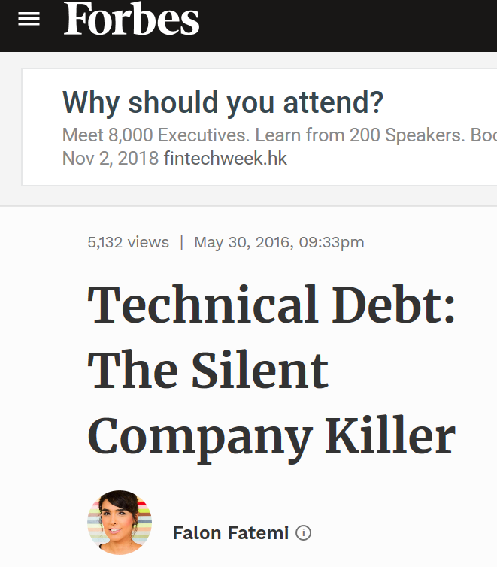
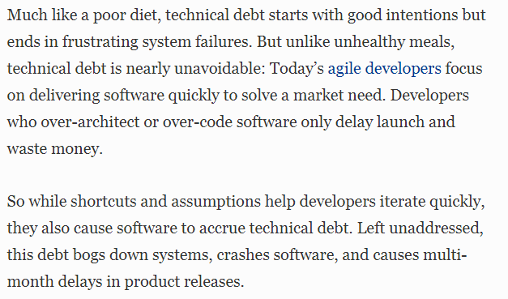
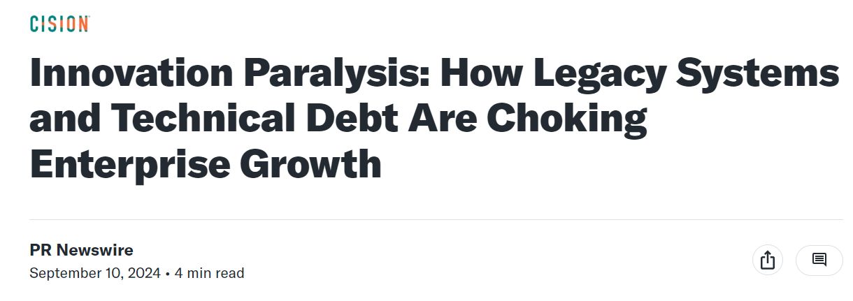
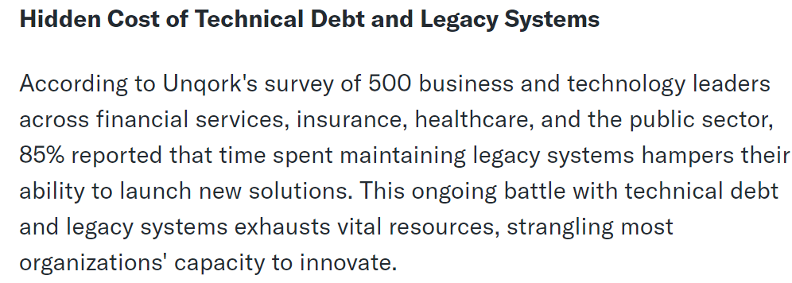
Technical Debt in Media

Slide 4

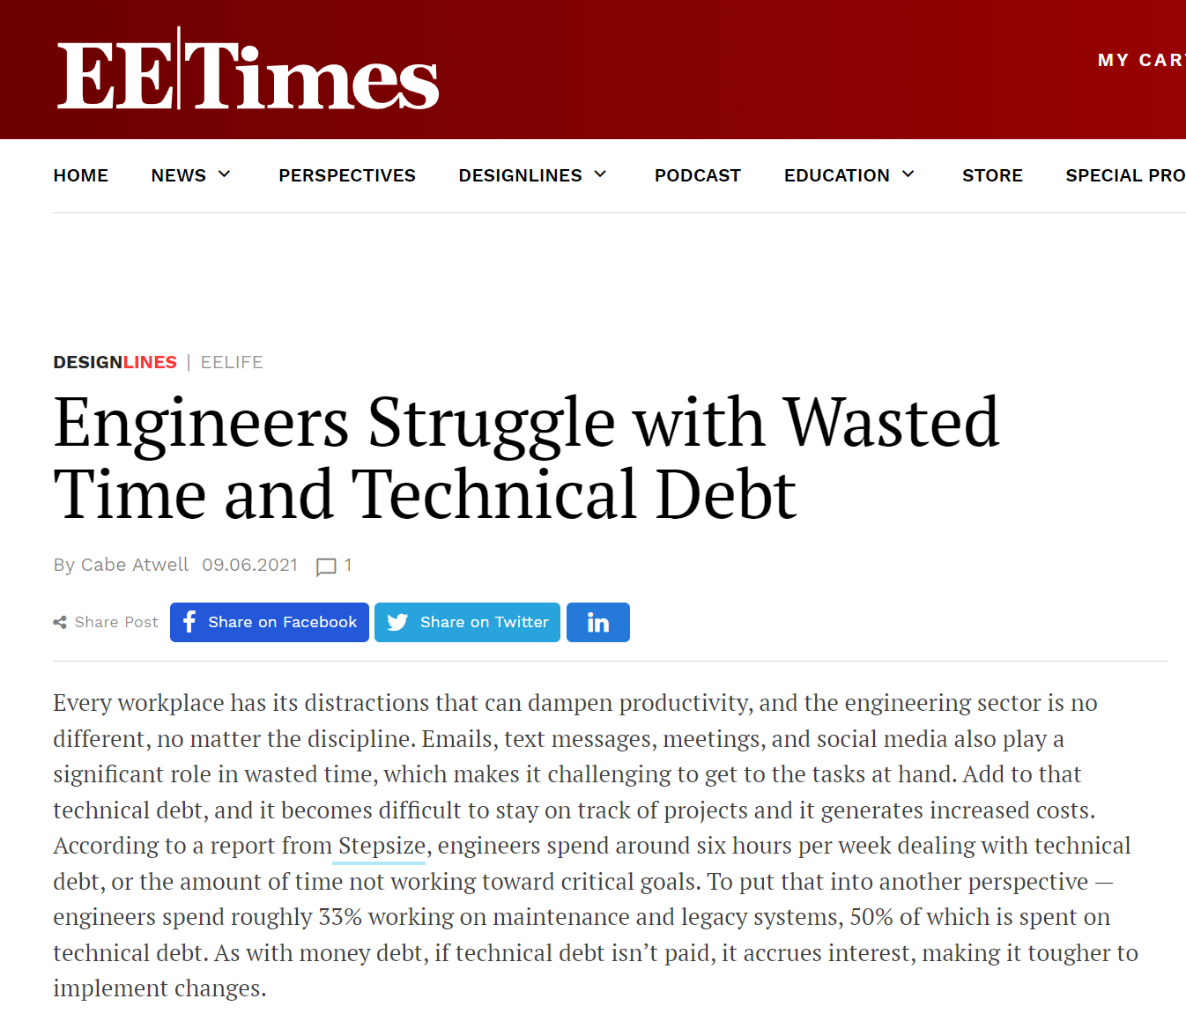
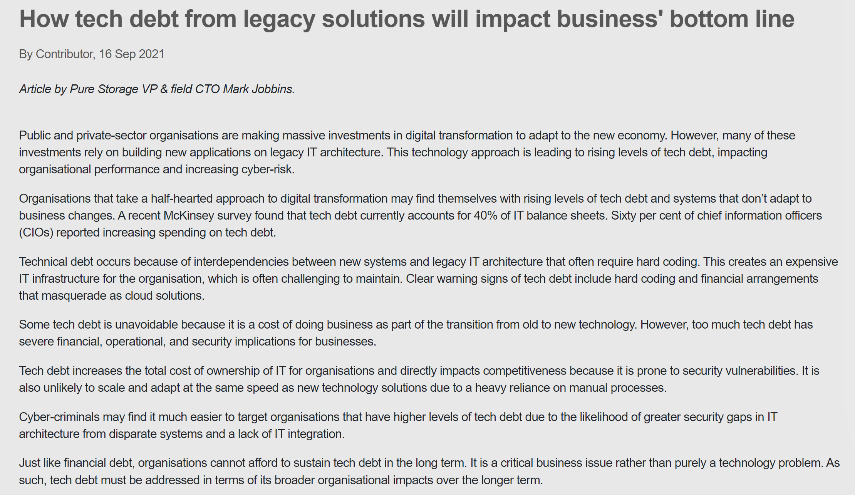
Technical Debt in Media

Slide 5
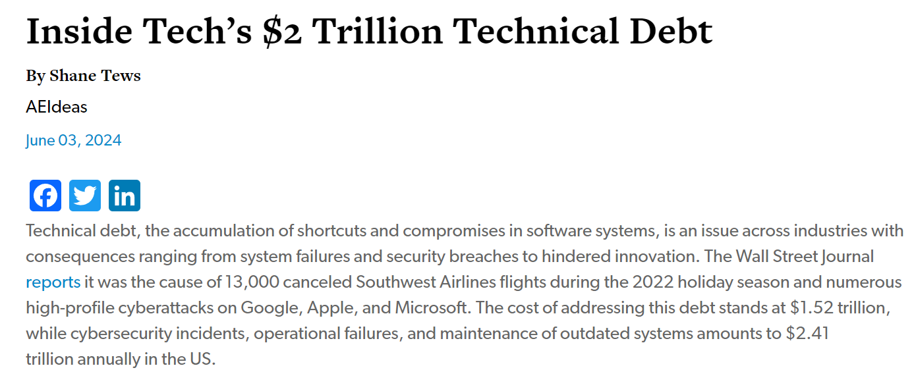
Technical Debt in Media

Slide 6

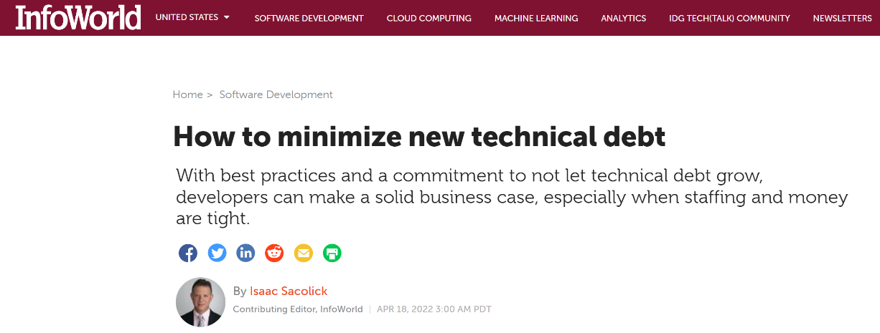
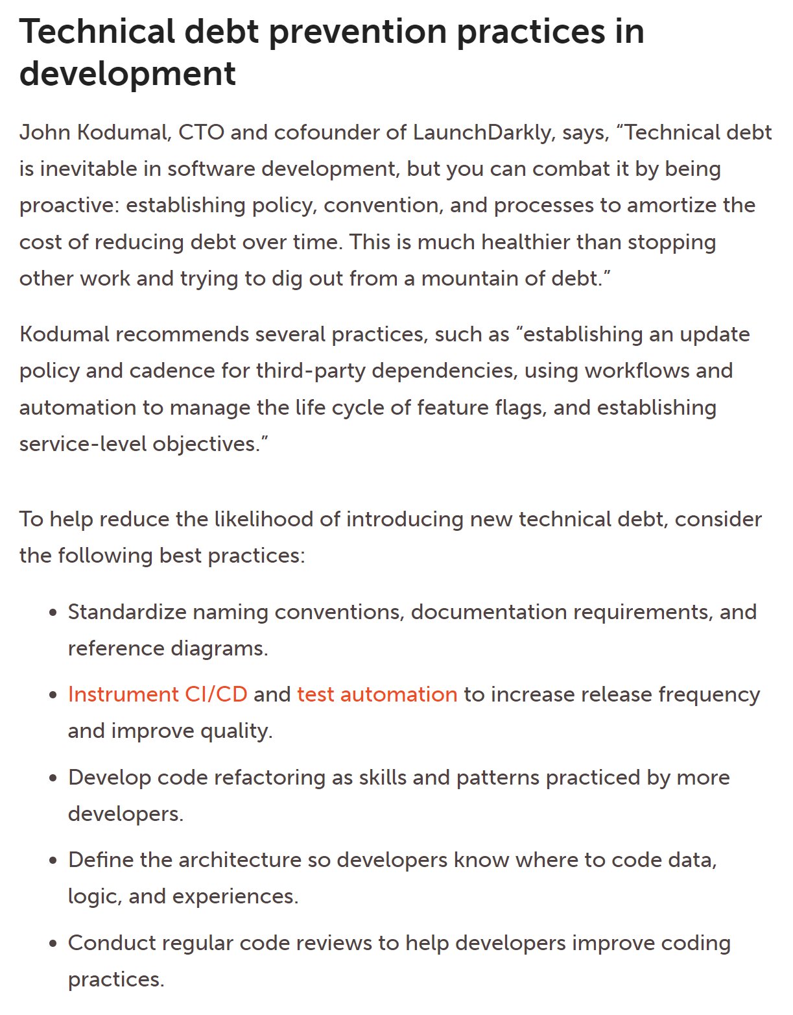
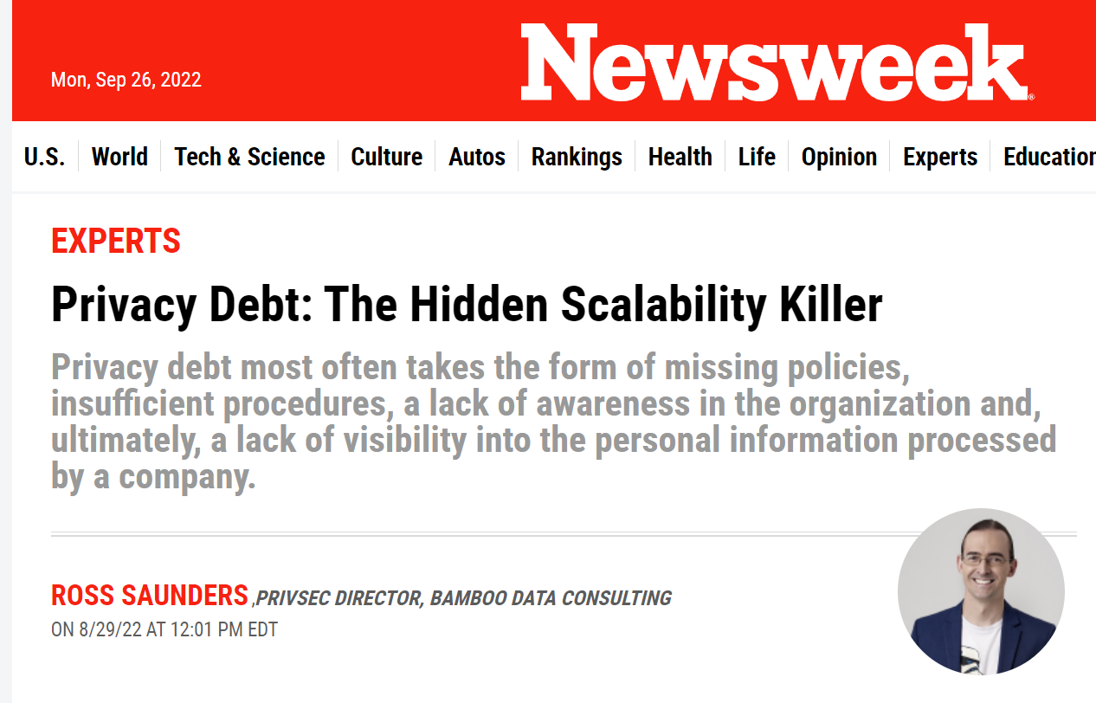
Technical Debt in Media

Slide 7
Technical Debt
Technical debt (TD)
is a metaphor originally proposed in 1992 [1]. The metaphor is that doing things in a “quick and dirty” way creates a technical debt (TD). Like a financial debt, TD incurs interest payments, which come in the form of the extra effort that developers must dedicate in future development because of this quick and dirty design choice.
is a design or construction approach that is expedient in the short term but that creates a technical context in which the same work will cost more to do later than it would cost to do now (including increased cost over time) [2].
Examples
“Guys, we don’t have time to dot every I and cross every T on this release. Just get the code done. It doesn’t have to be perfect. We’ll fix it after we release.”
“We don't have time to reconcile these two databases before our deadline, so we'll write some glue code that keeps them synchronized for now and reconcile them after we ship.”

Slide 8
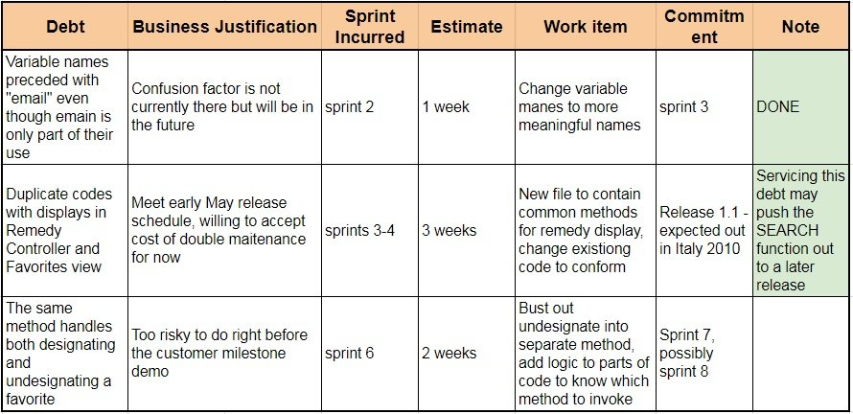
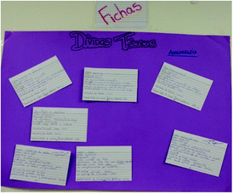
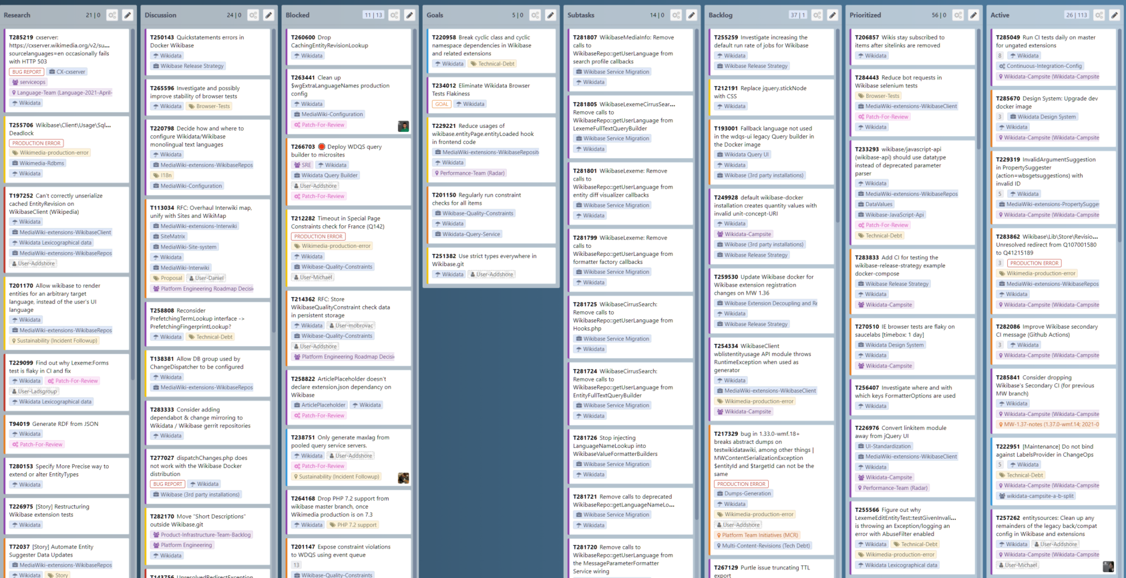
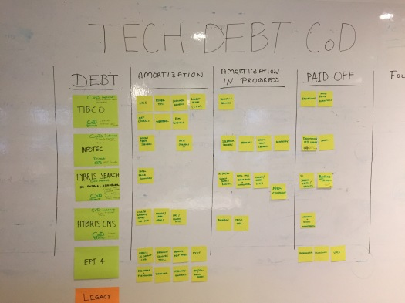
Examples
Technical debt in task board
https://qarea.com/blog/how-to-reduce-tech-debt-a-practical-experience-guide
https://addshore.com/2021/06/tackling-technical-debt-big-and-small-in-wikidata-and-wikibase/
https://theagilepmo.blog/2016/12/30/technical-debt-visualised-using-cost-of-delay/

Slide 9
Technical Debt incur, then pay interest, finally pay back
Typical scenario:
Sprint 1
Sprint 6
Sprint 10
Deliberate
…and Prudent
“Allow for touch pads? You aren’t going to need it!”
“Uh oh, we ARE going to need it! Let’s work around it for now…”
“Time to refactor – we’ve gotta fix it!”
Wrong - Incur the technical debt
Pay interest on the technical debt
Pay back the technical debt

Slide 10
Examples of “Interest Payments” on Technical Debt
e.g., Lack of unit tests on legacy code causes new development, testing, and debugging to take longer
e.g., Overly simple design does not readily support changes in the environment, and seemingly simple environment changes require massive code rework
e.g., High product support cost for a buggy system (non-software interest payment)
e.g., Brittle system means each bug-fix introduces unintended side effects (e.g., new bugs), so each bug-fix becomes a multibug-fix project
e.g., Bug reports are so frequent that time spent fixing bugs in the production system prevents any work on new functionality
e.g., Overly lengthy edit-compile-debug times due to poor development environment (non-code cause of technical debt)

Slide 11
Counterexamples of Technical Debts
Many kinds of delayed or incomplete work are not technical debt:
feature backlog, deferred features, cut features
In general, if “the same (development) work will not cost more to do later than it would cost to do now”, then it is not a technical debt.

Slide 12
Technical Debts in Practice [8]
Ernst et al. surveyed 1831 software engineers and architects found:
31% stated TD as an implicit part of their backlog
25% stated TD as an explicit part of their backlog
TD items commonly are not present in the official sprint backlog; they are often documented in quite ad-hoc managed shadow backlogs (i.e., “unofficial”, e.g., private notes of the team or a member, comments in source code commits).
A sprint backlog includes a mix of different items (e.g., new features, bugs/defects, and improvements). TD is often grouped as Improvements.
When TD is present in the software, the only significantly effective way of reducing TD is to refactor the software.

Slide 13
In-Class Exercise 1: Hard Choices
https://resources.sei.cmu.edu/asset_files/WhitePaper/2017_019_001_28931.pdf

Slide 14
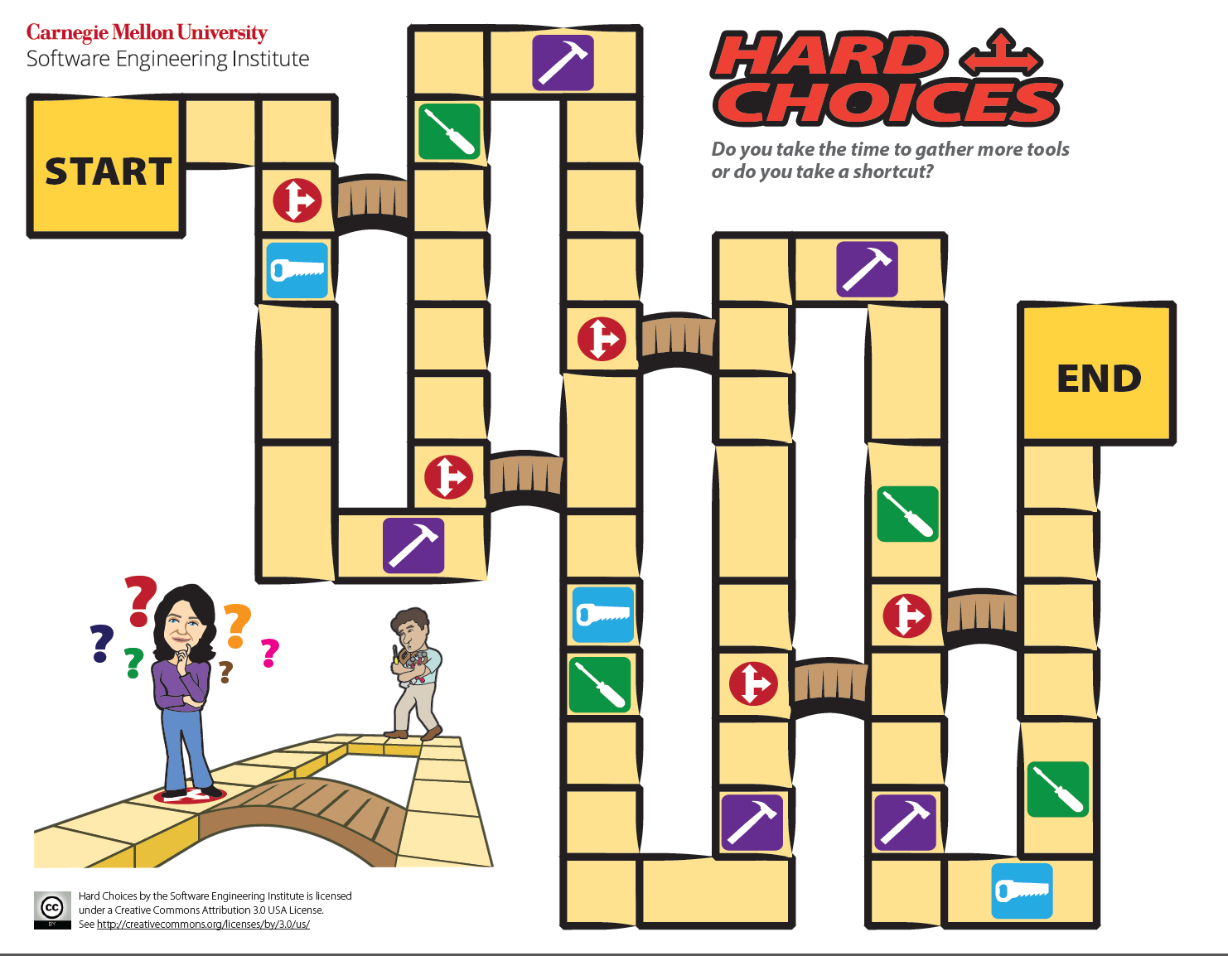

A team normally needs all three kinds of tools.
e.g., 4 players

Slide 15
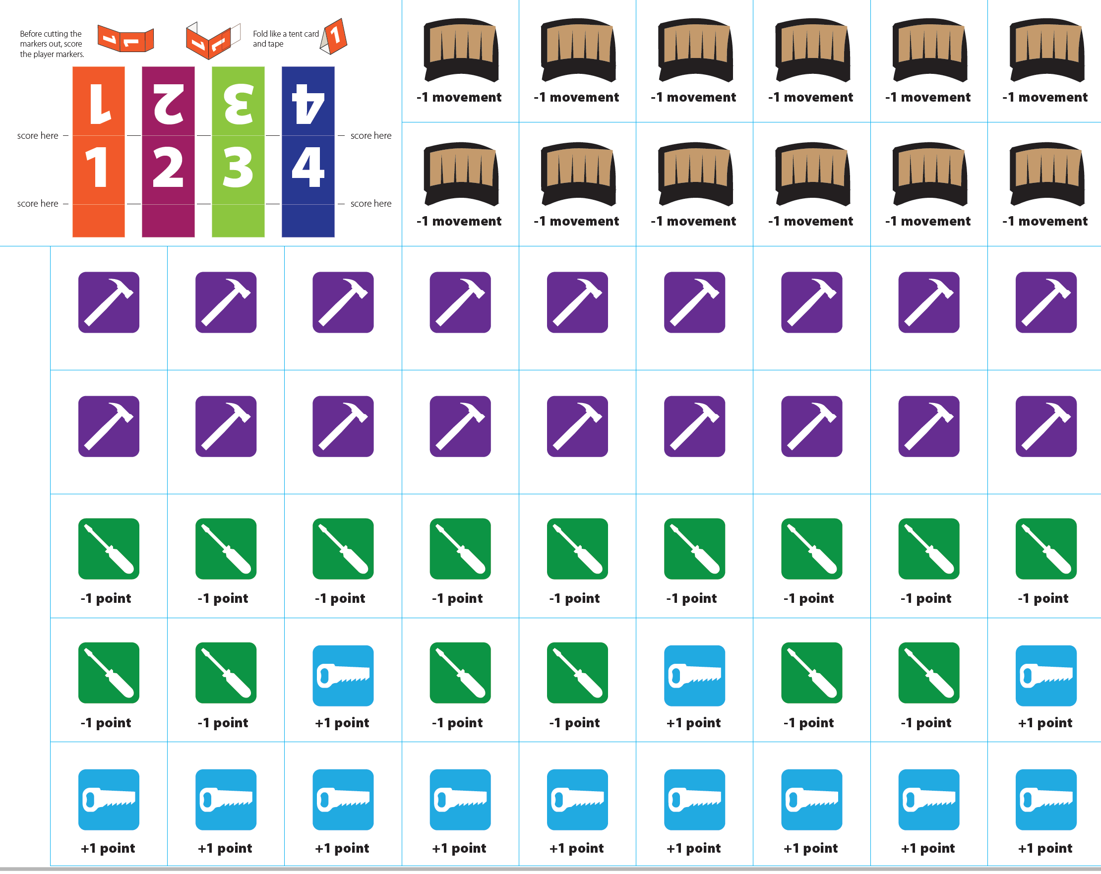
Cards

Slide 16

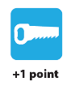
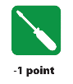




Game Rule in Brief
Roll a die to get a value N (e.g., 5)
Compute a value M based on N and sum of the points of the bridge cards in your row. (e.g., 5 + two = 5 - 2 = 3)
A player can get rid of a bridge (delete it from his row) by skipping a turn.
Choose to move your chess piece either (1) forward only or (2) forward then backward but not both with a total of M steps.
E.g., (a) 5 steps ahead. (b) 3 steps forward followed by 2 steps backward
If stepping on the hard choice square at the end of a move, you can choose one of the three directions for the next round.
If a move passes through or lands on a bridge , collect a bride card, place the bridge card in your row, and reduce M by 1 immediately before continuing the movement.
If a move steps on a tool finally, collect a tool card of that type.
Once any player reached “END”, all players in step 3 above can only move forward.
When all but one players reached “END”, the game end. i.e., the last player cannot finish the project.

Slide 17
Who Wins the Game?
Each card (irrespective to the type) counts as 1 point.
Passing through “END”
First player: 7 points
Second player: 5 points
Third player: 3 points
Fourth player: 1 points
Other player: no point
The player with the highest number of points in his rows win the game.

Slide 18


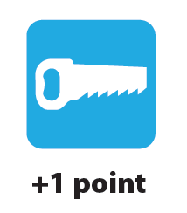

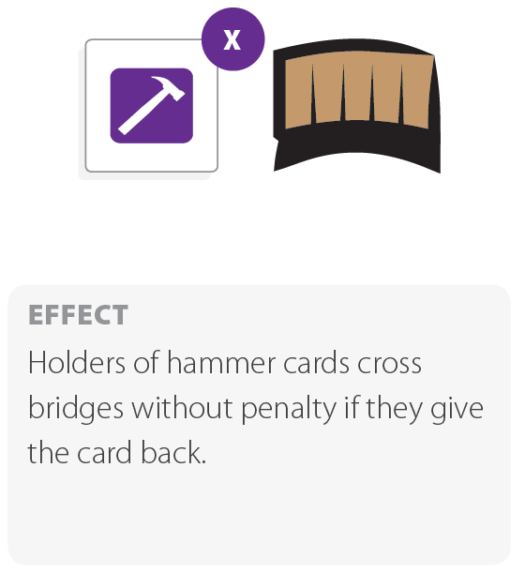
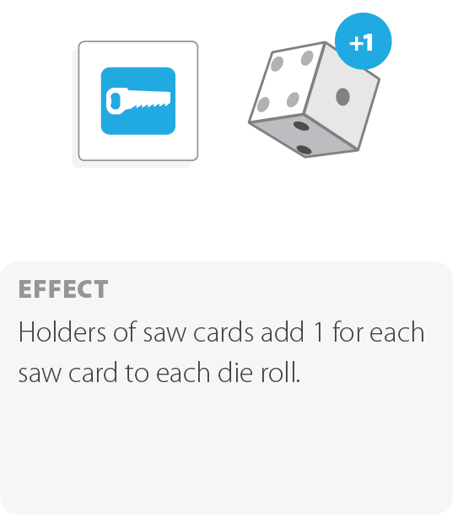
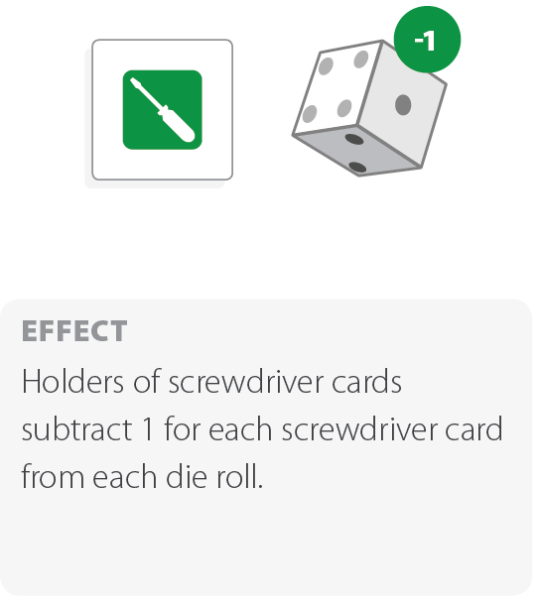
Effects of Tool Cards and Bride Card
On computing M in each round, modify M if the player holds each card instance below
Bride Card
Tool Cards
M--
M++
M--
Hammer cancels the effect of crossing a bridge in the current round only. The hammer card should back returned after used.

Slide 19
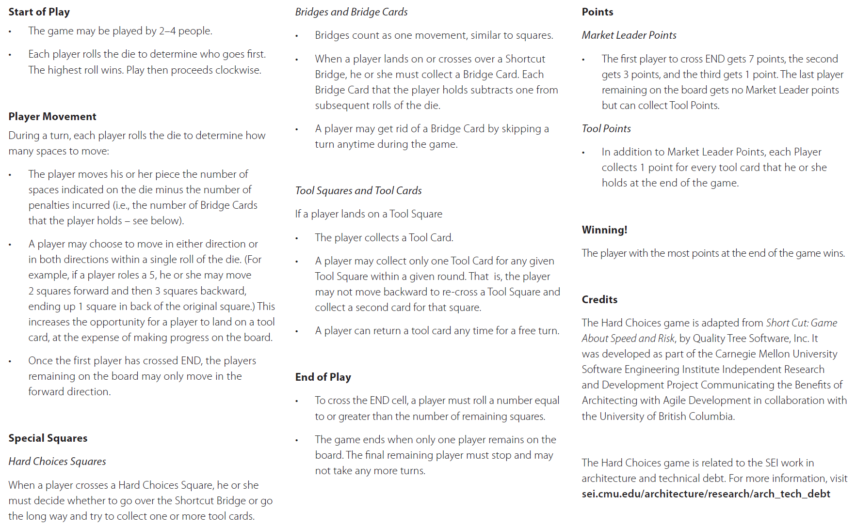
Full Game Rules
End Game

Slide 20
Impacts of Technical Debts
In some large organizations, development time dedicated to managing Technical Debt is substantial
an average of 25% of the overall development
Some said 40%-50%
Let’s look at how companies view technical debts (next slide)

Slide 21
Company View
Many companies tend to trade
their longer-term ability to produce new releases frequently, with high quality, quick feedback and small effort
in exchange for
short term features that might give them a quick fix but slow them down in the long run.
This strategy makes these companies vulnerable to their competitors

Slide 22
Two Sides of the Same Story with a Company [2]
Business View
Shorten time to market
Preserve startup investment
Delay development expense
Business staff tend to be optimistic about the benefit and the costs. These attitudes are often unconscious.
Technical View
Technical staff tends to be pessimistic about the benefit and the costs. These attitudes are often unconscious.
Take on debt
Debt reduces productivity
Less time for new features
Behind schedule

Slide 23
Technical Debt and Its Basic Management
Technical debts have been classified by dimension:
Type (e.g., design, testing, or documentation debt),
Intentionality (intentionally or unintentionally),
Time horizon (short or long term), and
Degree of focus.
(Popular) Technical Debts management idea
Identify a technical debt and track it through product backlog of the software project. Discuss them.
E.g., put the following into the backlog: “We don't have time to reconcile these two databases before our deadline, so we'll write some glue code that keeps them synchronized for now and reconcile them after we ship.”
Use them to judge a technical debt

Slide 24
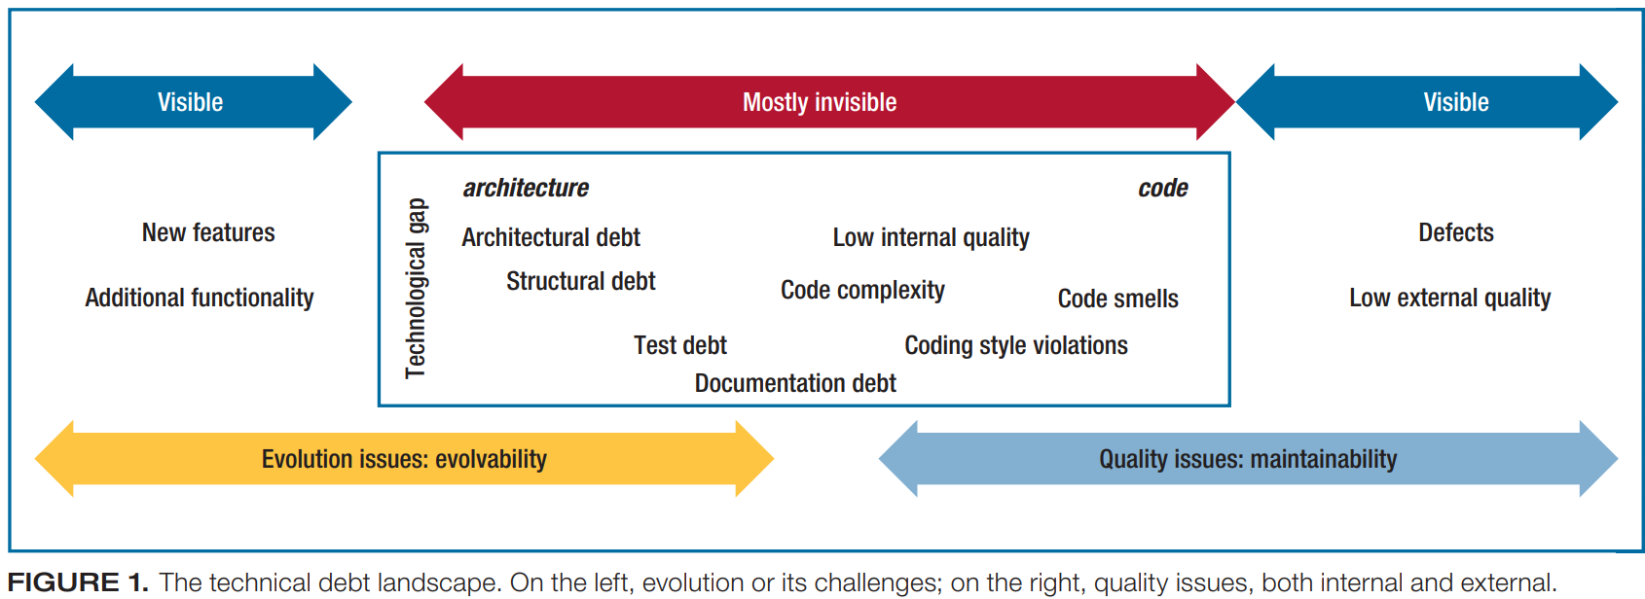
Dimension 1: Types of Technical Debt
Technical Debt is not just a coding problem.
Refactoring out the code smells cannot solve them all.
[3]
Notes:
The image is taken from Ref [3]: Philippe Kruchten, Robert L. Nord, and Ipek Ozkaya. 2012. Technical Debt: From Metaphor to Theory and Practice. IEEE Softw. 29, 6 (November 2012), 18-21. DOI: https://doi.org/10.1109/MS.2012.167 .

Slide 25
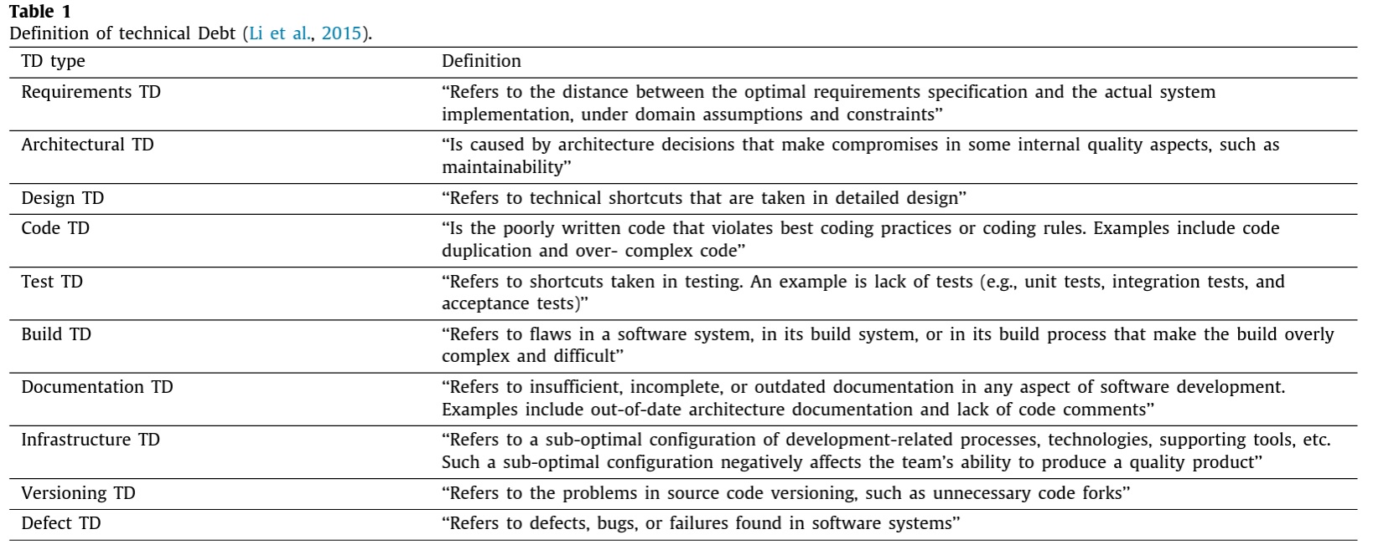
Dimension 1: Types of Technical Debt
https://doi.org/10.1016/j.jss.2020.110827

Slide 26
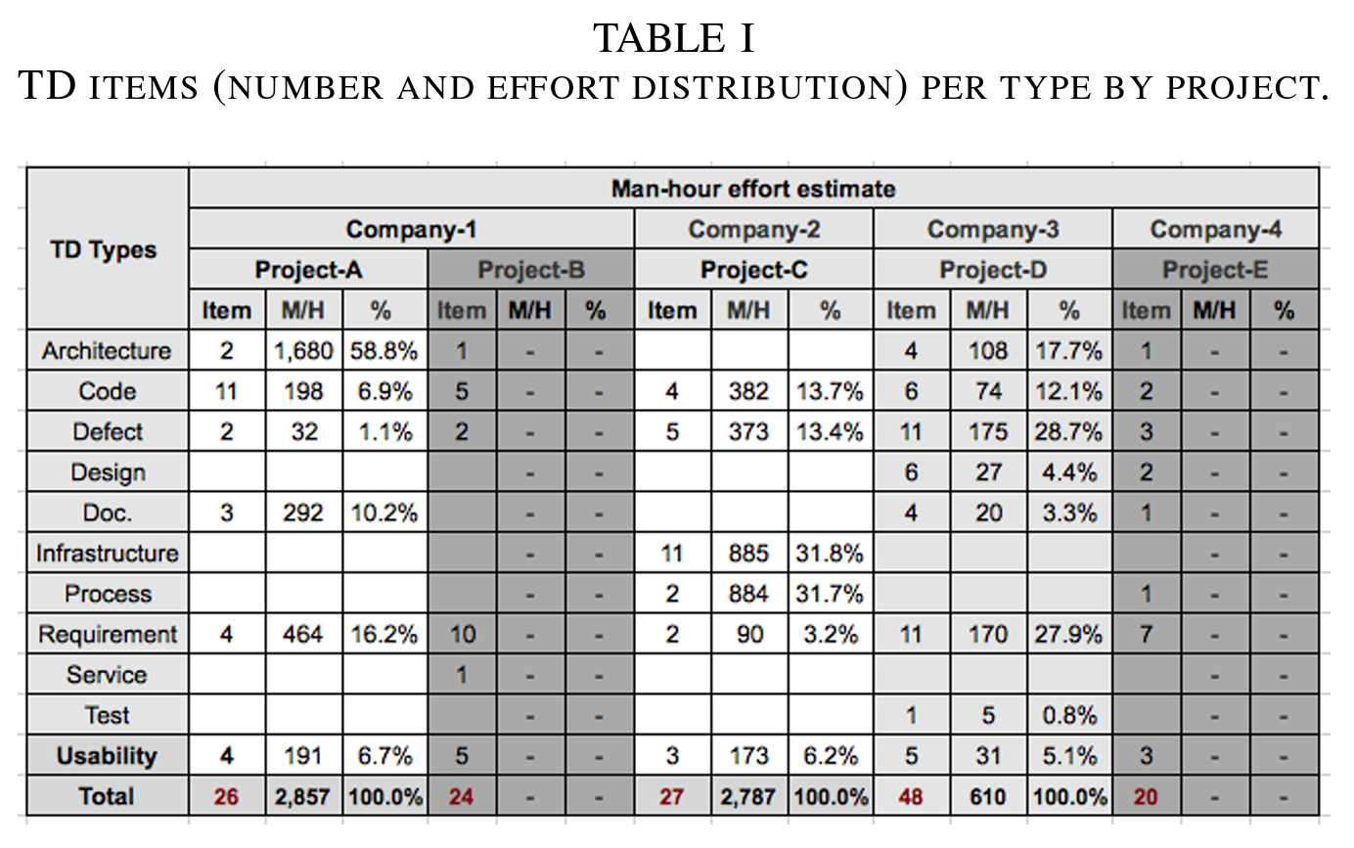
Dimension 1: Types of Technical Debt
https://doi.org/10.1109/ESEM.2019.8870180
Spread over all development lifecycle phases

Slide 27
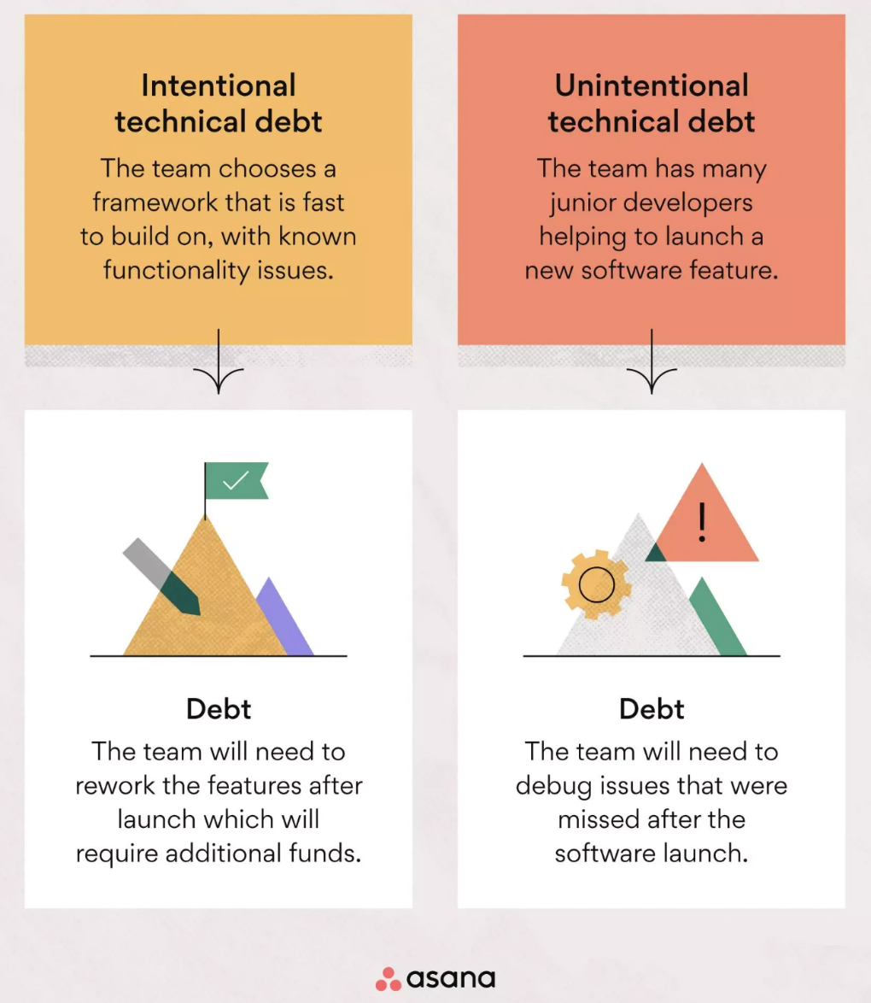
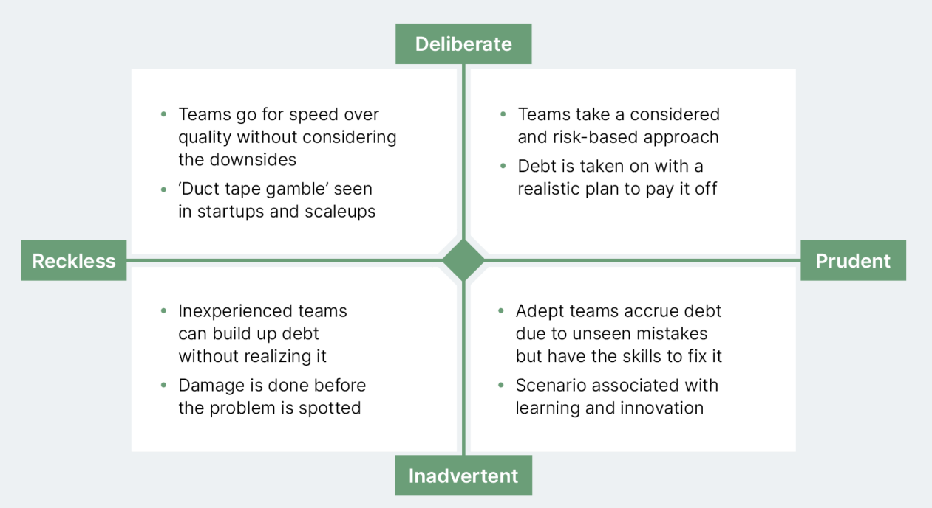
Dimension 2: Intentionality of Technical Debt
Examples on the Web
Ignorant to do better
Intentional
Knowledgeable to do better
Unintentional
See the examples in the next slide
https://asana.com/zh-tw/resources/technical-debt

Slide 28
Dimension 2: Intentionality of Technical Debt
Examples:
Prudent and deliberate: Ship the product quickly and address any issues later. This debt is created when the benefits of a quick delivery outweigh the risks (the stakes in the software project are relatively low).
Reckless and deliberate: Know how to produce the best code but prioritize quick product delivery over producing the best code. It will result in legacy code that is harder to maintain.
Prudent and inadvertent: It occurs when the team aims to write the best code but later discovers a better solution after implementation.
Reckless and inadvertent: It occurs when a team attempts to write the best code without having the necessary knowledge to do so. They may not realize the mistakes they’re committing. This can introduce vulnerabilities and maintainability issues.

Slide 29
Dimension 2: Intentionality of Technical Debt
Intentional Technical Debt
Debt incurred by intention
e.g., “If we don’t get this release done, there won’t be a second release.”
e.g., “We don’t have time to build in general support for multiple platforms. We’ll support iOS now and build in support for Android, etc., later.”
e.g., “We didn’t have time to write unit tests for all the code we wrote the last 2 months of the project. We’ll write those after we release.”

Slide 30
Dimension 2: Intentionality of Technical Debt
Unintentional Technical Debt
Debt incurred unintentionally due to low quality work.
e.g., A junior programmer writes bad code
e.g., A newcomer/contractor writes code that doesn’t follow the coding standard
e.g., A major design strategy (e.g., decide to use the model-view-controller architecture to connect all major modules in the software) turns out poorly
e.g., Your company acquires a company that has a lot of technical debt
e.g., A comprehensive refactoring task goes sideways
e.g., Honest Mistakes. “I wish we’d known Framework 2.1 would be so much better than Framework 2.0.”
e.g., Careless Mistakes. “Design? What design? Hardware design?

Slide 31
Dimension 3: Time Horizon
Short-Term Debt
Usually incurred reactively, for tactical reasons
e.g., Skipping some integration tests to get a release out the door
e.g., "We don't have time to implement this the right way; just hack it in, and we'll fix it after we ship."
e.g., Violating coding standards to upload a hotfix
Long-Term Debt
Usually incurred proactively, for strategic reasons
e.g., “We don’t think we’re going to need to support a second platform for at least 3 years, so our design supports only one platform.”

Slide 32
Dimension 4: Degree of Focus
Focused Debt
Debts that are intentionally incurred and managed.
Unfocused debt
Debts accumulated when the team has no clear strategy or priority for managing and addressing technical debts
 | Unfocused Debt | Focused debt
Prioritization | Not systematic | Systematically identified and managed
Planning | Reactive. No long-term planning strategy | Proactive. Long-term planning exists
Documentation | Poor | Good
Accumulation | Growing and unmanageable | Managed and proactively reduced
Communication | Insufficient within the team | Ongoing within the team

Slide 33
Dimension 4: Degree of Focus
Examples of Unfocused Debts
A legacy application with mixed functions and classes, making it hard to understand and change.
New features are added without unit tests, leading to a fragile codebase that breaks easily.
Features are merged quickly without proper code review, resulting in low-quality code that needs extensive rework.
The application uses an old framework with known security issues and no plans for updating, increasing risk.
A software product has accumulated many features over time, making its codebase bloated and hard to manage.
The application lags during peak usage, with performance optimizations ignored in favor of adding new features.
An outdated CRM or ERP system is used that doesn't integrate well with modern applications, leading to duplicated efforts and data issues.

Slide 34
Dimension 4: Degree of Focus
Examples of Focused Debts
Deliberate shortcuts for time-to-market
Temporary code workarounds
Code simplicity over complexity
Deferring non-critical refactoring
Selectively use legacy solutions
Inadequate testing for quicker delivery
Experimental feature in production
Skipping documentation
Limited error handling
Implementing high-priority features while knowing the underlying infrastructure inadequate
Prototype code in production
Deferring external library’s dependency update
Use naïve/simplified algorithms or data structure
Feature cut for meeting deadlines

Slide 35
Identify Technical Debts

Slide 36
Patterns to Increase Technical Debts
There are some well-known patterns in software development to increase technical debts
Schedule Pressure
Duplication of Code
Get it “right” the first time

Slide 37
Patterns to Increase Technical Debts: 1. Schedule Pressure
When a team is held to a commitment that is unreasonable, they are bound to cut corners to meet management expectations.
E.g., creeping scope of new features, change in team composition, late integration
Solution
Use a more flexible planning approach

Slide 38
Patterns to Increase Technical Debts: 2. Duplication of Code
Many reasons for code duplications
Lack of experience on part of the team members
Copy-and-paste programming practice
Conform to the poor design of existing software
Pressure to deliver; guess a schedule
Solution
Use static analysis tool for assistance (see Code for Quality slides)
Pair programming
To spread the knowledge and improve competence of team members
Either (a) Repay debts now or (b) Track it if replay later,
(1) fix it now, (2) add runtime exception to location of technical debts and fix it a few minutes later, (3) add the debt (location, description, potential cost of not fixing it) to the project backlog

Slide 39
Patterns to Increase Technical Debts: 3. Get it “right” the first time
Opposite of duplication – create a lot of powerful design up-front.
We have over-engineered and over-generalized our intended product.
Costs associated with fixing keep growing

Slide 40
Manage Technical Debts

Slide 41
Mange Technical Debts [5]
If we can’t avoid technical debt, we must manage it.
This means recognizing it, tracking it, making reasoned decisions about it, and preventing its worst consequences.

Slide 42
Methods to Manage Technical Debts: Tracking Technical Debts [2]
Tracking technical debts (TD) is necessary to manage them.
All “good debt” can be tracked (at least by definition)
Log as defects
Include in product backlogs
Monitor project velocity
Monitor amount of rework
Ways to Measure Debt
Total of debt in product backlog
Maintenance budget (or fraction of maintenance budget)
Measure debt in money, not features, e.g., “50% of R&D budget is nonproductive maintenance work”

Slide 43
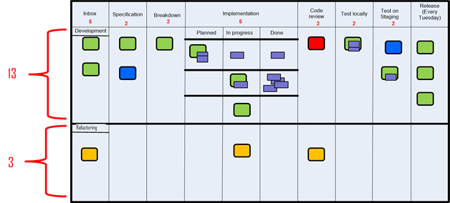
Methods to Manage Technical Debts: Tracking Technical Debts Visually [6]
Visualize the technical debts on task boards. The lower section includes three refactoring tasks (i.e., instances of technical debts) to be addressed in a project: one is under code review, another one is “in progress”, and the last one has not been handled at all.
Notes:
Jesper Boeg, Successfully balancing technical debt and new features – staying in the “flow-zone” or how to get back in there. http://agileupgrade.com/successfully-balancing-technical-depth-and-new-features-staying-in-the-flow-zone-or-how-to-get-back-in-there/

Slide 44
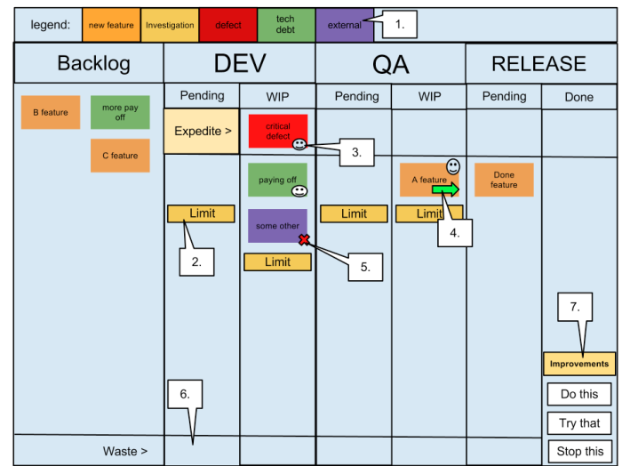
Methods to Manage Technical Debts: Tracking Technical Debts Visually [6]
Visualize the technical debts on Kanban board. (for the 1-7, see the next
slide)
Notes:
http://www.iainjmitchell.com/blog/kanban-board-tour
Legend – This shows the types of cards (by colour) that can be on the board, these include New features, Tech debt, Defects, Investigations (support) and External Issues (e.g. new servers). The purpose of this is to clearly visualise the type of work that is being processed
Limits – Each pending and work in progress column has a limit to control the amount of work that can be taken on. These limits are set based on resource levels and other bottlenecks, and are intended to encourage the PULLING of work when capacity exists rather than continuing to force more work onto a bottleneck.
Avatar – Each team member has ONE avatar to place on the item they are on, this tells other team members that this card is being worked upon and should be progressing. As we pair on most development, there will often be more than one avatar on each Dev task.
Arrows – Indicate movement of tasks since the last standup, again this is part of the visualisation of the process. These cards are often ignored at the standup, as we want to focus on the items that are not progressing, such as…
Blockers – We want to minimise blockers as they cause more bottlenecks in the system, so we clearly indicate these items with blocked avatar. An additional requirement to blocking a card is to add the details of WHO and WHY the item is unable to proceed.
Waste – Tasks can be abandoned at any stage in the process, we collect these and review at the weekly retrospective.
Continuous Improvements – Also, at the weekly retrospective we decide upon three improvement points that we want to tackle for the following week. These are summarised on the board and recalled at the beginning of the morning standup, if we fail to make any progress on an improvement then it may be rolled over to the next week.

Slide 45
The seven legends on the last slide
Legend – This shows the types of cards (by color) that can be on the board, these include New features, Tech debt, Defects, Investigations (support) and External Issues (e.g. new servers). The purpose of this is to clearly visualize the type of work that is being processed
Limits – Each pending and work in progress column has a limit to control the amount of work that can be taken on. These limits are set based on resource levels and other bottlenecks, and are intended to encourage the PULLING of work when capacity exists rather than continuing to force more work onto a bottleneck.
Avatar – Each team member has ONE avatar to place on the item they are on, this tells other team members that this card is being worked upon and should be progressing. As we pair on most development, there will often be more than one avatar on each Dev task.
Arrows – Indicate movement of tasks since the last standup, again this is part of the visualization of the process. These cards are often ignored at the standup, as we want to focus on the items that are not progressing, such as…
Blockers – We want to minimize blockers as they cause more bottlenecks in the system, so we clearly indicate these items with blocked avatar. An additional requirement to blocking a card is to add the details of WHO and WHY the item is unable to proceed.
Waste – Tasks can be abandoned at any stage in the process, we collect these and review at the weekly retrospective.
Continuous Improvements – Also, at the weekly retrospective we decide upon three improvement points that we want to tackle for the following week. These are summarized on the board and recalled at the beginning of the morning standup, if we fail to make any progress on an improvement then it may be rolled over to the next week.
Notes:
http://www.iainjmitchell.com/blog/kanban-board-tour

Slide 46
Methods to Manage Technical Debts: Repay Technical Debts
An effective tactic is to reserve a timeslot on a periodic basis to deal with technical debt.
Longer time for refactoring to trade for smaller number of refactoring cycles, and vice versa.
Prioritize refactoring tasks to address the critical areas first.
Involve product owners and stakeholders to get their perspectives
time
Feature development
refactoring
Feature development
refactoring
Notes:
Jesper Boeg, Successfully balancing technical debt and new features – staying in the “flow-zone” or how to get back in there. http://agileupgrade.com/successfully-balancing-technical-depth-and-new-features-staying-in-the-flow-zone-or-how-to-get-back-in-there/

Slide 47
Methods to Manage Technical Debts: Discuss Technical Debts
Helps to educate technical staff about business decision making involved in the project
Fit developers into the business context
Helps to educate business staff about technical decision making
Also serve as an aspect of the inputs to their business or operational decisions
Raises awareness/transparency of important issues that are often covered up in the project
As a risk aversion measure
Allows technical debts to be managed more explicitly and visually
As a starting point for a project to resolve them one by one.

Slide 48
In-Class Exercise 2: Dice Game for Technical Debt

Slide 49
Technical Debt Card Game: Dice of Debt
We use a simple card game to get technical debts in action: http://tastycupcakes.org/2018/03/dice-of-debt/
This game illustrates the importance of dealing with technical debt. Within 10 sprints, a software development team aims to deliver as much software value as possible. The team can invest in measures that reduce the burden of technical debt. While there’s a short-term price, these measures also bring long-term benefits.
These two images are embedded PDF files. Double-click them to open the PDF to read.

Slide 50
Dice of Debt: Instructions 1-2 out of 4
The team has 12 dice, representing the team’s capacity. Some of that capacity will be available to create new software value. Technical debt will consume the rest of that capacity.
To start, the team has 8 New Value (NV) dice.
To start, the team has 4 Technical Debt (TD) dice.
Every turn represents a sprint. Each turn, the team rolls dice to determine how much software value they will create.
First, roll the NV dice. Get the total A from all the dice rolled.
Second, roll the TD dice. Get the total B.
Compute A - B, is the actual amount of value created this turn.
[continue…]
https://www.random.org/dice/?num=8
https://www.random.org/dice/?num=4

Slide 51
Dice of Debt: Instructions 3-4 out of 4
Before rolling the dice, in each turn, the team can decide to invest in measures that will reduce technical debt. Each measure has a cost, measured in New Value dice that will be unavailable for a number of turns.
See the next slide for the costs and benefits of the four measures.
Once the team has met the required cost (for example, removing 2 New Value Dice for 3 sprints), the team gets the benefit from the next sprint onwards by getting back the New Value dice invested in the technical debt-reducing measure.
Each measure has a different benefit. Some shift capacity (dice) that used to be spent on technical debt into the New Value pool.
At the end of 10 turns, total the cumulative value created across all sprints. That’s the team’s final score. The tracking sheet lets you compare your score to a baseline, representing the average score for teams that didn’t invest in any technical debt-reducing measures.

Slide 52
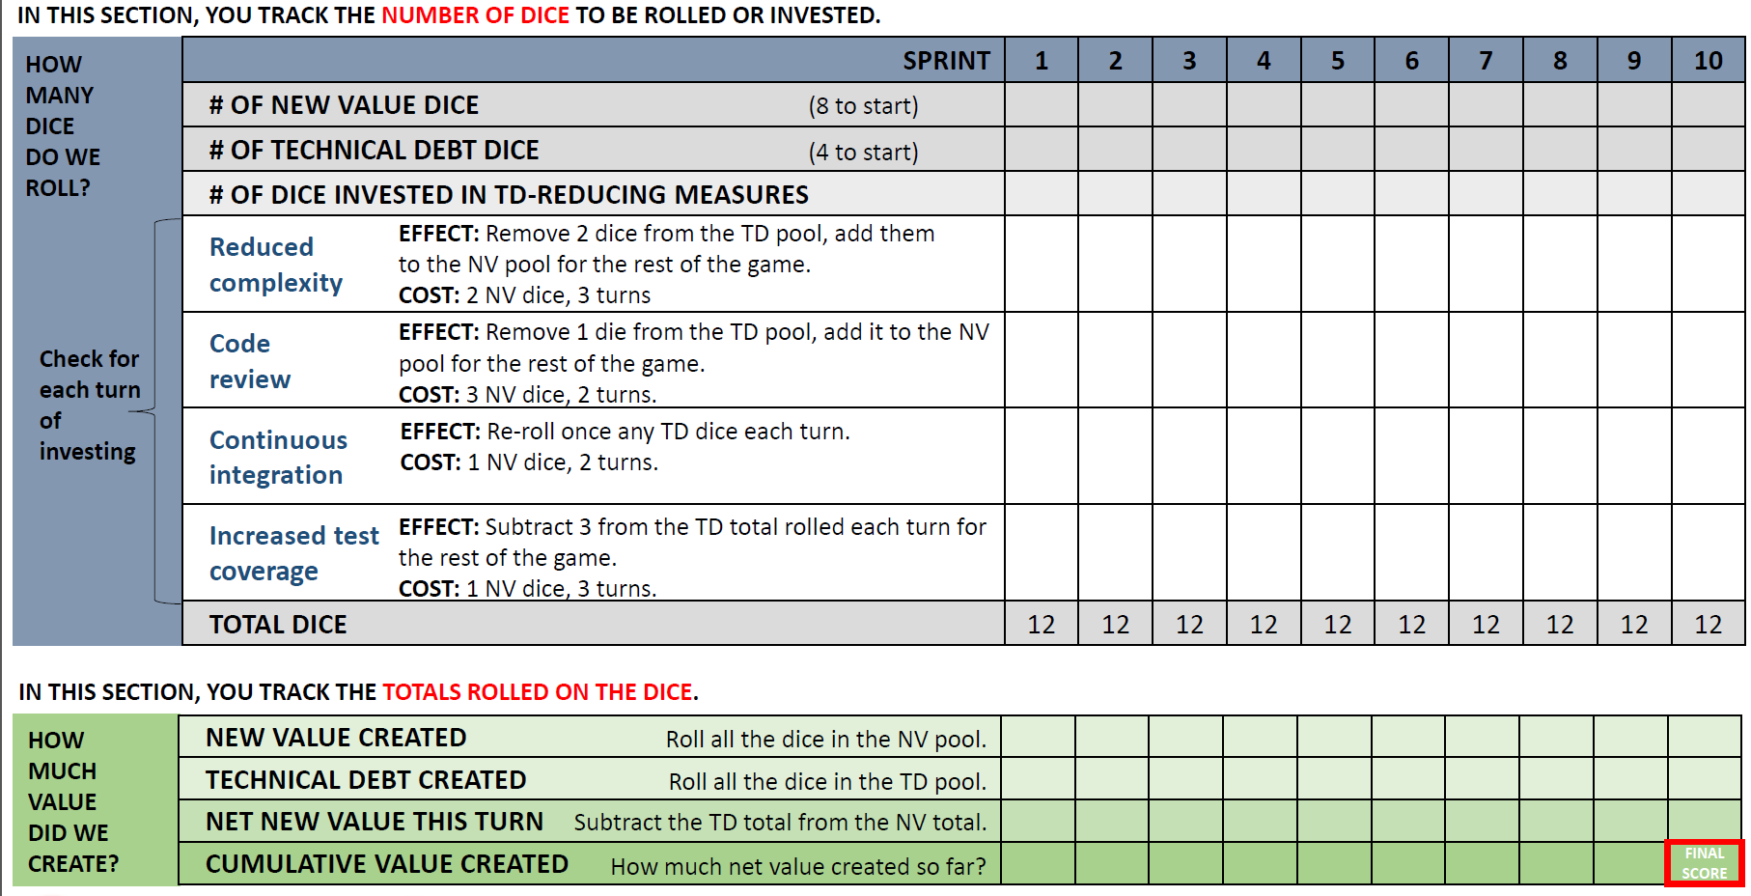
Dice of Debt: Scoring Sheet
A
B

Slide 53
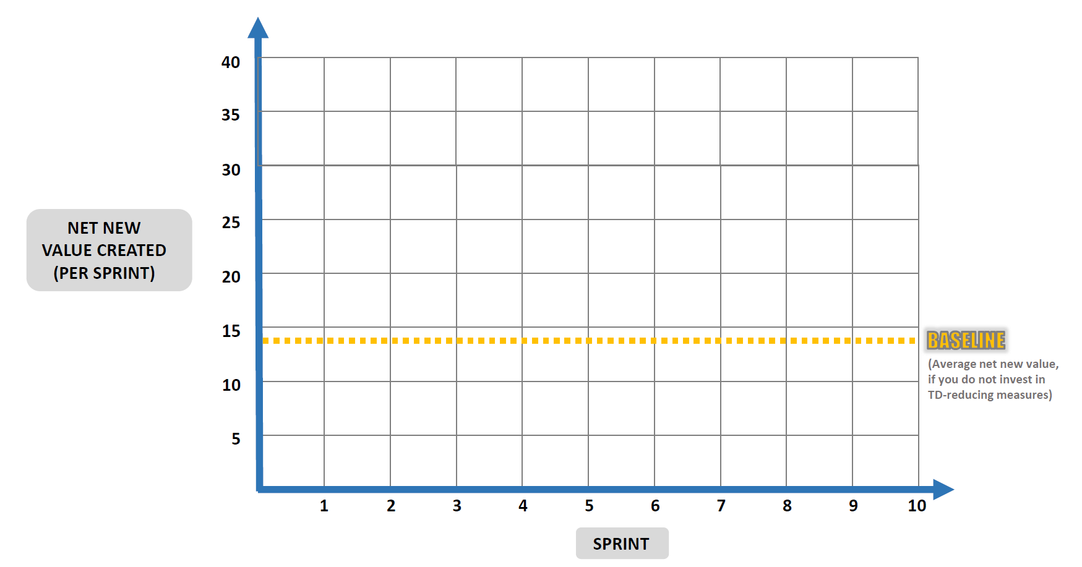
Dice of Debt: Tracking Sheet

Slide 54
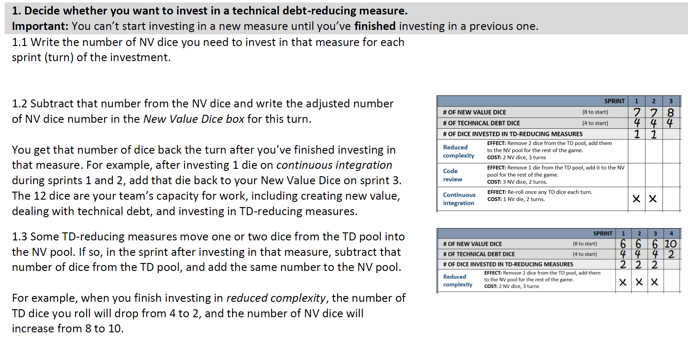
How to Play the Game
1 + 7 = 8
Example 1:
Example 2:

Slide 55
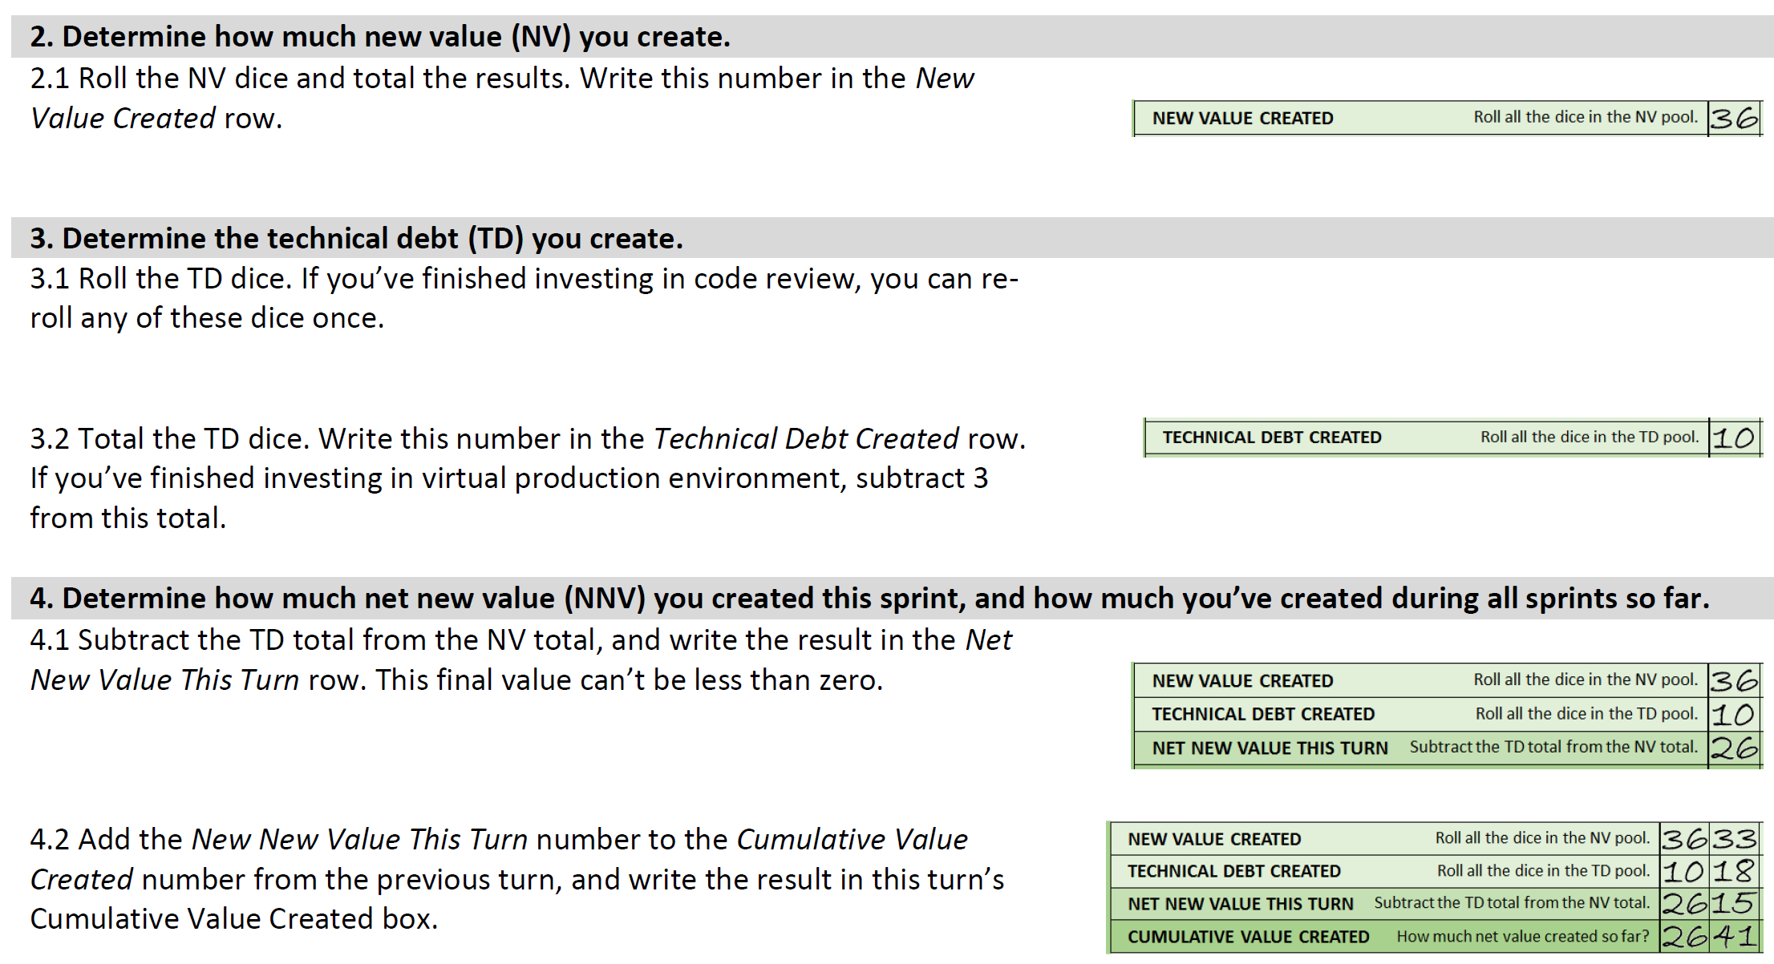
How to Play the Game
Notes:
Question: a scenario is that initially, a project creates very few new values (smaller than the one without investing into any best practice) by investing too much on these practices. In this case, the project may already be killed in the first few sprints due to low value creation. This is undesirable.

Slide 56
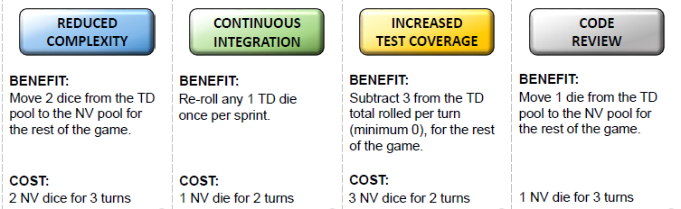
How to Play the Game: Uncertain Outcomes
In real world, we could not get precisely the cost and benefit of each practice we adopt in a project.
If you wish, change the “to-reducing measure” instead of using these four predefined cost-benefit pairs.
Pre-Game Instruction:
1. For each such measure, one student in the team is responsible to change the cost-benefit pair.
2. Keep the change private to that student. When a turn picks a particular to-reducing measure, the cost-benefit pair is revealed to the team.
Change to 2, 2, 4 instead of the predefined 1, 1, 2?

Slide 57
State of the Practices in Managing Technical Debt

Slide 58
Managing Technical Debts in Practice
Although most developers may have expressed a desire for better ways of doing all these things, and yet they did not do it.
Strategies in workplaces (from a survey [5] on 26 companies)
Do nothing—“if it ain’t broke, don’t fix it”—because the debt might not ever become visible to the customer.
Use a risk management approach to evaluating and prioritizing technical debt’s cost and value. E.g., allocate 5 to 10 percent of each release cycle to addressing technical debt.
Manage the expectations of customers and nontechnical stakeholders by making them equal partners and facilitating open dialogue about the debt’s implications.
Conduct audits with the development team to make technical debt visible and explicit; track it using a backlog/task board.

Slide 59
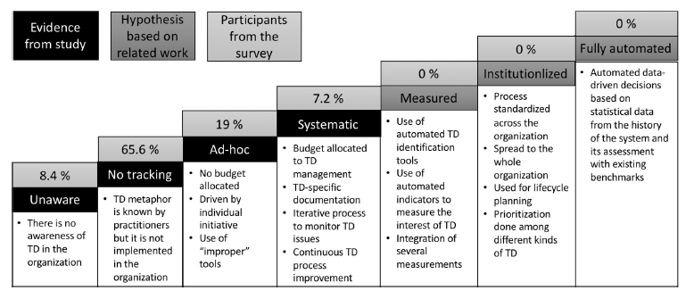
Managing Technical Debts in Practice [7]
We are here
A survey [7] conducted in 2017: 226 participants from 15 large organizations with different roles (developers, architects, managers)

Slide 60
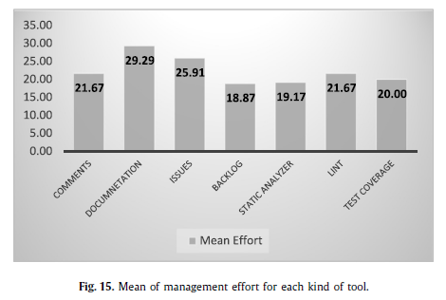
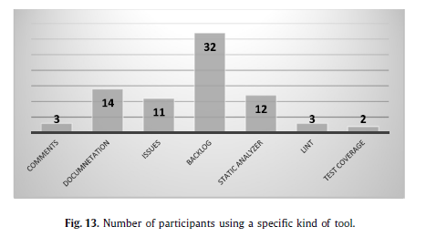
Managing Technical Debts in Practice [7]
highest
lowest
See the next slide for the qualitative analysis on these tools

Slide 61
Managing Technical Debts in Practice [7]
[Effective] Backlogs, static analyzers and “lint” programs all increase the tracking level, but we cannot see a big difference (although static code analyzers seem to contribute better to the participants’ awareness). They are also the ones with the least overhead. They therefore seem to be considered the best practices at the moment to track TD.
[Effective] Backlogs are the most used tool among the participants. In particular, the most used backlog tools are Jira, Hansoft, and Excel.
[Ineffective] Comments in the code help awareness, but they are not considered tracking, and they are used by just 1% of the respondents. This is probably because they are not used in a document that can be monitored by the team outside the code.
[Ineffective] Documentation increases TD awareness, but it is not considered as a high level of tracking, and it has the highest overhead. The main tools used here were Microsoft Excel or Word. We can infer that this practice is not recommendable in comparison with the other ones.
[Ineffective] Using a bug system for tracking TD is not considered as contributing to a better level of awareness or tracking compared to the other techniques, and it has a slightly higher overhead. We would infer that this is also not the best way of tracking TD.
[Ineffective] Test coverage does not seem to contribute too much to the awareness and tracking level, although it does not involve much overhead. This might be because test coverage is related to only a small part of TD.

Slide 62
Generative AI and Technical Debt
[9] The Hidden Costs of Coding With Generative AI. MIT SLOAN Management Review (Aug 2025), also available at https://tribunecontentagency.com/article/the-hidden-costs-of-coding-with-generative-ai/

Slide 63
The Hidden Costs of Coding With Generative AI
Good
Up to 55% more productive when using Copilot
McKinsey has found that developers can complete tasks up to twice as fast with generative AI assistance
Bad
Technical Debt Grows Faster With AI
The “2024 Accelerate State of DevOps” report from Google’s DevOps Research and Assessment team found that a 25% increase in AI usage improves code review and documentation but results in a 7.2% decrease in delivery stability. So, what looks like rapid progress today could turn into costly setbacks tomorrow.
“AI can’t see what your code base is like, so it can’t adhere to the way things have been done.”

Slide 64
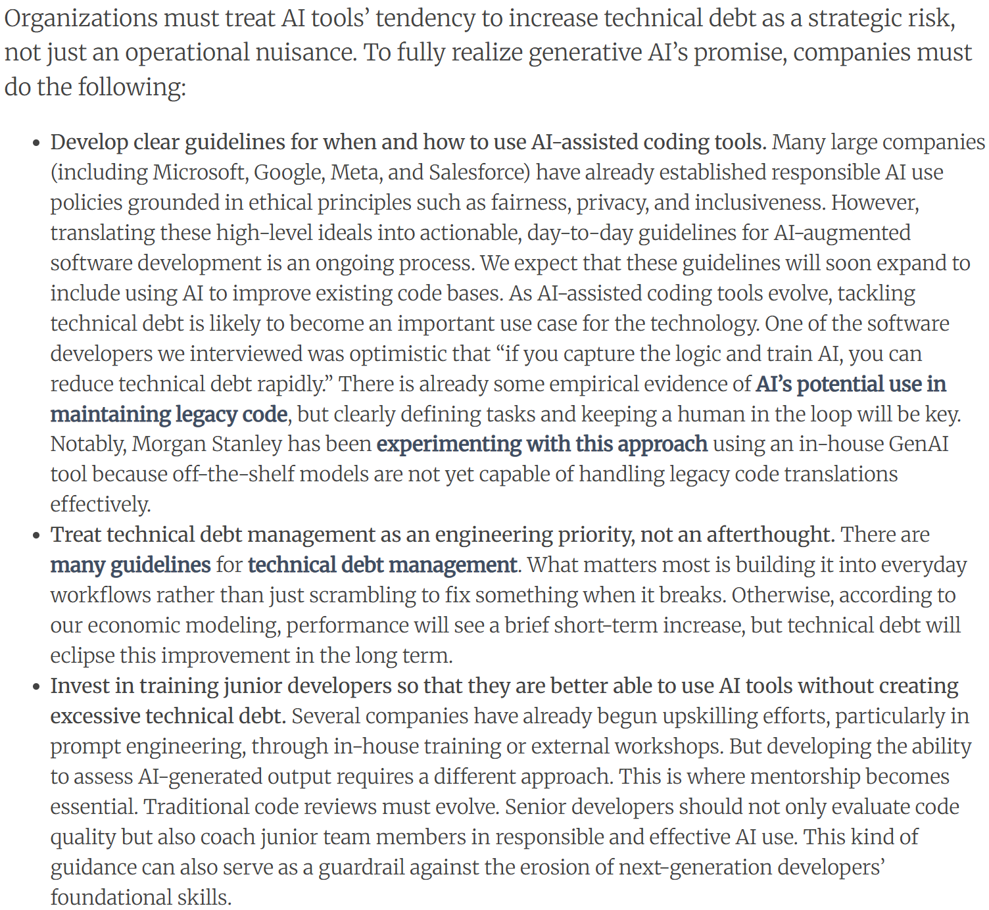
TD with AI
Low-skilled software developers are more likely to let AI-generated technical debt snowball. Highly skilled developers are better equipped to recognize architectural flaws and mitigate technical debt before it spreads

Slide 65
References and Resources
Ward Cunningham. 1992. The WyCash portfolio management system. In Addendum to the proceedings on Object-oriented programming systems, languages, and applications (Addendum) (OOPSLA '92), Jerry L. Archibald and Mark C. Wilkes (Eds.). ACM, New York, NY, USA, 29-30. DOI=http://dx.doi.org/10.1145/157709.157715
S. McConnell, "Managing technical debt (slides)," in Workshop on Managing Technical Debt (part of ICSE 2013): IEEE, 2013
http://2013.icse-conferences.org/documents/publicity/MTD-WS-McConnell-slides.pdf
Philippe Kruchten, Robert L. Nord, and Ipek Ozkaya. 2012. Technical Debt: From Metaphor to Theory and Practice. IEEE Softw. 29, 6 (November 2012), 18-21. DOI: https://doi.org/10.1109/MS.2012.167
Chris Sterling, 2010. Managing Software Debt: Building for Inevitable Change. Addison-Wesley Professional; 1 edition, ISBN-10: 0321948610. [a good resource to know technical debts]
Lim, N. Taksande, and C. Seaman, “A balancing act: What software practitioners have to say about technical debt,” IEEE Software. DOI: 10.1109/MS.2012.130
Jesper Boeg, Successfully balancing technical debt and new features – staying in the “flow-zone” or how to get back in there. http://agileupgrade.com/successfully-balancing-technical-depth-and-new-features-staying-in-the-flow-zone-or-how-to-get-back-in-there/
Antonio Martini, Tersese Besker, Jan Bosch: Technical Debt tracking: Current state of practice: A survey and multiple case study in 15 large organizations. Sci. Comput. Program. 163: 42-61 (2018)
Terese Besker, Antonio Martini, and Jan Bosch. 2019. Technical debt triage in backlog management. In Proceedings of the Second International Conference on Technical Debt (TechDebt '19). IEEE Press, Piscataway, NJ, USA, 13-22. DOI: https://doi.org/10.1109/TechDebt.2019.00010
The Hidden Costs of Coding With Generative AI. https://tribunecontentagency.com/article/the-hidden-costs-of-coding-with-generative-ai/ (2025)

